Slide 1

PYTHON MASTERCLASS
Live Class 1: Fundamental Logic & Data Structures
Strings • Numbers • Logic • Collections • Loops

Slide 2
CLASS ROADMAP
Strings: Methods & Formatting
Lists & Tuples: Methods Deep Dive
Math: Precedence & Functions
Sets & Dicts: Key Operations
Logic: Comparisons & If-Else
Loops: For, While & range()
Matching: Ternary & Match Case
Practice: Dummy Problem Solving

Slide 3

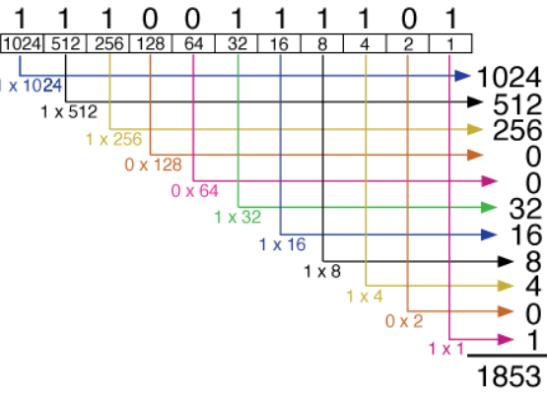
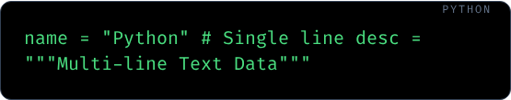
STRINGS: TEXTUAL FOUNDATION
Strings are immutable sequences of characters.
Zero-indexed access: name[0]
Slicing: name[0:2]

Slide 4





FORMATTED STRINGS (F-STRINGS)
Efficiency
Embedding
Expressions
Introduced in Python 3.6, f-strings are the fastest way to format text.
Variables are placed directly inside {curly braces}.
Evaluate math or calls inside the string: f"{10*2}"

Slide 5
STRING METHODS: CASE CONTROL
Method | Output Description | Example
.upper() | ALL CAPITALS | "python" → "PYTHON"
.lower() | all lowercase | "PYthon" → "python"
.title() | First Letter Capital | "hello world" → "Hello World"
.capitalize() | First letter only | "python is fun" → "Python is fun"

Slide 6
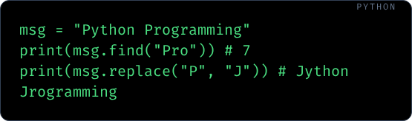
STRING METHODS: DISCOVERY
.find('p'): Returns first index or -1 if not found.
.replace('a', 'b'): Swaps all occurrences.
.count('s'): Frequency of substring.

Slide 7



STRING METHODS: VALIDATION
.isalpha()
.isnumeric()
.strip()
True if string is letters only (no spaces/nums).
True if string consists of digits only.
Removes leading and trailing whitespace.

Slide 8
SPLITTING & JOINING STRINGS
Crucial for parsing CSV data or user inputs.

Slide 9
PROBLEM 1: INPUT SANITIZER
Scenario: A user provides their email with accidental spaces and mixed cases.

Slide 10



NUMBERS: INTS & FLOATS
int
float
Whole Numbers
Decimals

Slide 11
ARITHMETIC OPERATORS
Symbol | Operation | Example
** | Exponent (Power) | 2 ** 3 → 8
/ | Float Division | 10 / 3 → 3.33
// | Floor Division | 10 // 3 → 3
% | Modulus (Remainder) | 10 % 3 → 1

Slide 12
OPERATOR PRECEDENCE

Slide 13
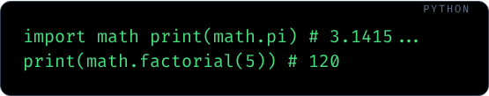
THE MATH MODULE
math.ceil(2.1): 3 (Always up)
math.floor(2.9): 2 (Always down)
math.sqrt(16): 4.0

Slide 14

PROBLEM 2: CIRCLE AREA
Goal: Calculate circle area given radius r = 5.

Slide 15
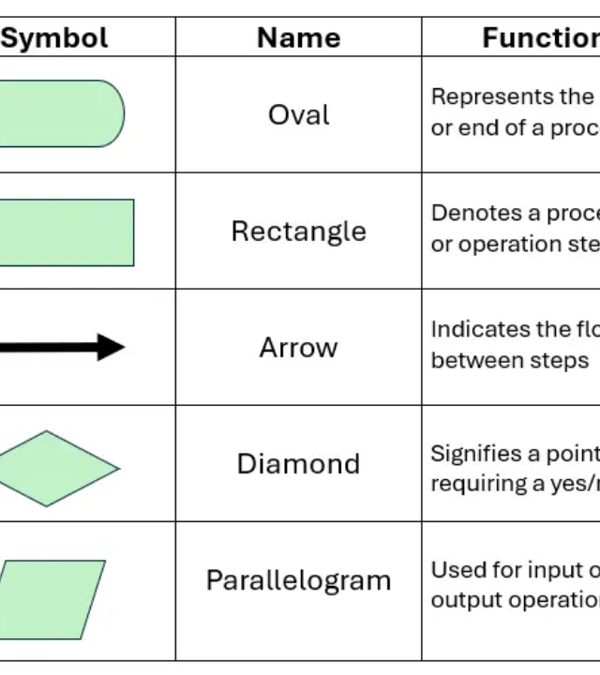
COMPARISONS
== Equality
!= Not Equal
> / < Greater / Less
>= / <= Bound comparisons
Result is always True or False.

Slide 16



LOGICAL OPERATORS
and
or
not
True if BOTH conditions are met.
True if AT LEAST ONE is met.
INVERTS the Boolean result.

Slide 17

CONDITIONAL DECISION
Structure
Indentation defines code blocks. elif is optional and can repeat. else is the final catch-all.

Slide 18
TERNARY OPERATOR
A compact way to write if-else in a single line.
Syntax: Result1 if Condition else Result2

Slide 19
MATCH CASE (SWITCH)
Structural Pattern Matching (Python 3.10+).

Slide 20
PROBLEM 3: CINEMA TICKET
Scenario: Price depends on age.
Under 5: Free
5-17: $10
18+: $20

Slide 21
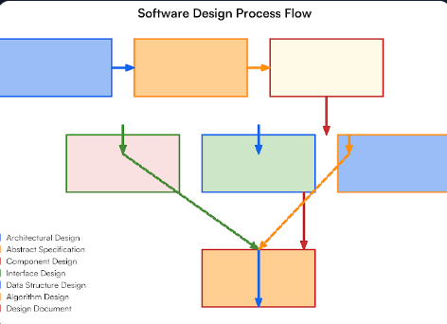
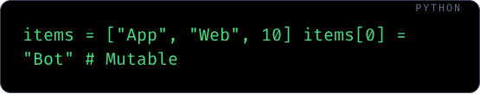
LISTS: DYNAMIC ARRAYS
Ordered, mutable collections of items.

Slide 22
LIST METHODS: GROWING
.append(x)
.extend(list)
.insert(i, x)
Adds one item to the very end.
Adds multiple items from another list.
Adds item at specific index i.

Slide 23
LIST METHODS: SHRINKING
Method | Behavior
.pop() | Removes and returns last item.
.pop(index) | Removes item at specific index.
.remove(val) | Removes first occurrence of value.
.clear() | Deletes all items.

Slide 24
LIST METHODS: ORDER
.sort(): Modifies original list in ascending order.
.reverse(): Flips the order of elements.
.copy(): Returns a shallow copy.

Slide 25
PROBLEM 4: TASK MANAGER
Goal: Add "Coding" to tasks, remove "Email", and sort.

Slide 26
TUPLES: READ-ONLY
Fixed sequences that cannot be changed after creation.
Faster than lists. Used for fixed constants (GPS, Colors).

Slide 27
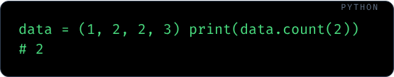
TUPLE METHODS & UNPACKING
.count(x): Count occurrences.
.index(x): Find first index.
Unpacking: x, y = (10, 20)

Slide 28

SETS: UNIQUE COLLECTIONS
Unordered collection of unique items. No duplicates allowed!

Slide 29
SET OPERATIONS
.add(x)
.union(s)
.intersection(s)
Inserts item (ignored if already present).
Combines items from both sets (no duplicates).
Only items found in BOTH sets.

Slide 30
PROBLEM 5: UNIQUE LOGINS
Goal: Extract unique usernames from a list of logs.

Slide 31
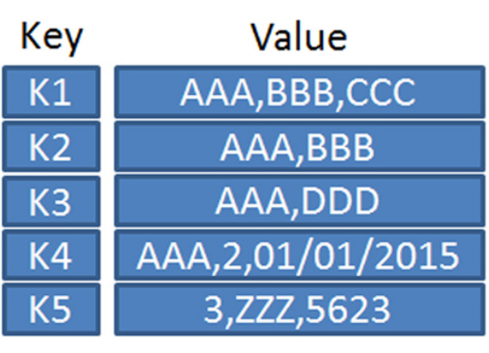
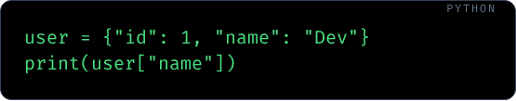
DICTIONARIES: KEY-VALUE
Mappable data structures (Key → Value).

Slide 32
DICT METHODS: ACCESS
.get(key, default): Safely access keys (no errors).
.keys(): Returns list of all keys.
.values(): Returns list of all values.
.items(): Returns key-value pairs (tuples).

Slide 33
DICT METHODS: MODIFYING
Use popitem() to remove the last inserted pair.

Slide 34
PROBLEM 6: STOCK TRACKER

Slide 35
FOR LOOPS BASICS
Used to iterate over items in a collection or a range.

Slide 36

RANGE & ENUMERATE
range(5)
enumerate(list)
Generates numbers 0 to 4.
Returns index and value pairs.

Slide 37
WHILE LOOPS
Repeats as long as a condition is True.

Slide 38



LOOP CONTROL
break
continue
pass
Exits the loop entirely.
Skips to the next iteration.
Does nothing (placeholder).

Slide 39
FINAL CHALLENGE
Task: Find the sum of even numbers in a list using a loop.

Slide 40

Any Questions?
Next Class: Functional Programming & Modules
Keep Coding!

